Slide 1
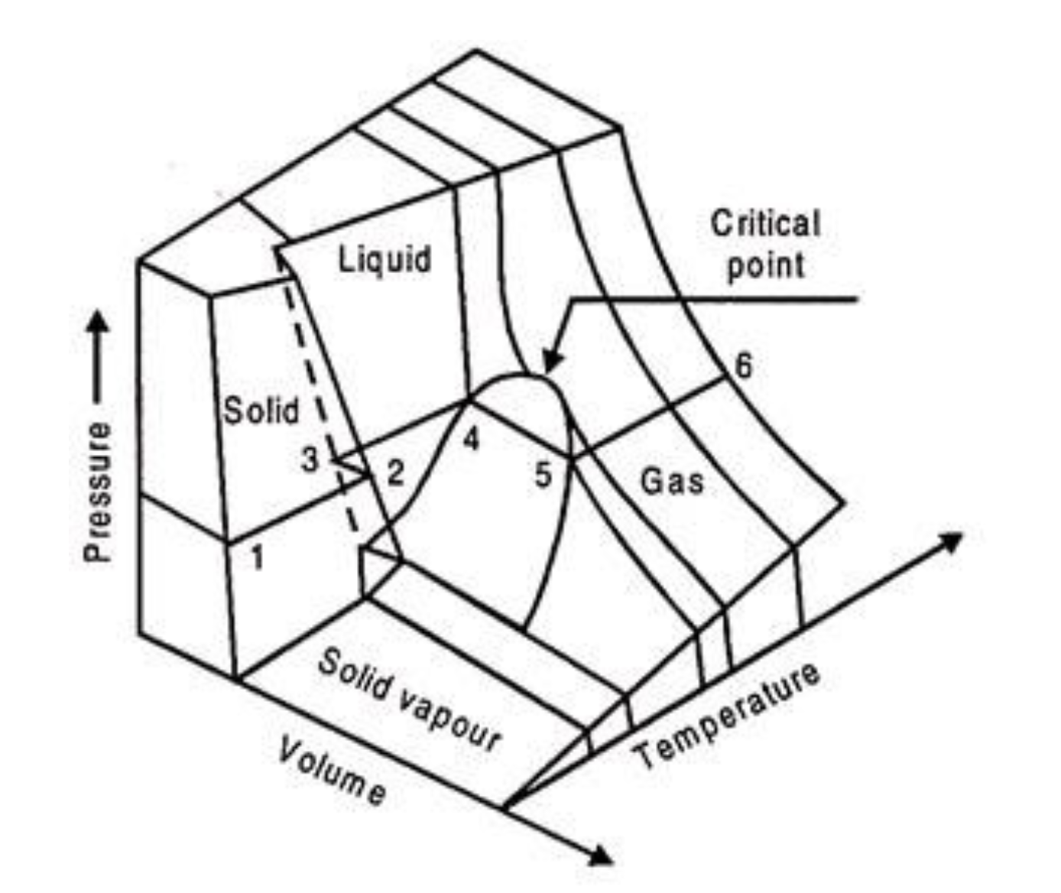
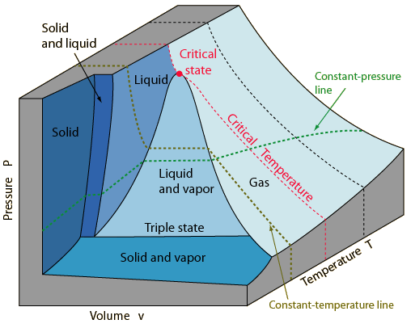
What all gases/liquids/solids do
The Principle of Corresponding States says all substances do this, just at different temperatures and volumes.
Here, we’ll focus on the critical point.
https://www.engineeringenotes.com/thermal-engineering/real-gases/real-gases-properties-van-der-waals-equation-and-equation-of-state-thermal-engineering/49112

Slide 2


How you can tell if a gas is supercritical or subcritical
Isothermal compression below and above the critical temperature
$$T<T_{c}$$
$$T>T_{c}$$
gas
gas
Super-critical Gas/
Liquid
gas
liquid
liquid
liquid

Slide 3
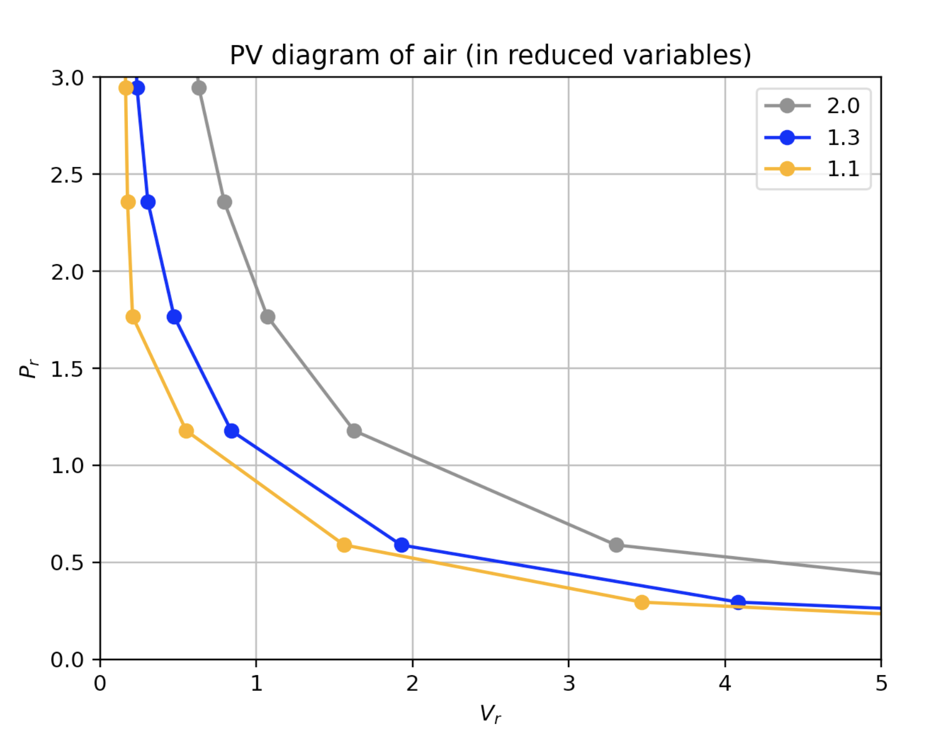
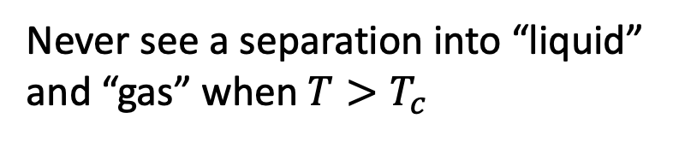
How you can tell if a gas is supercritical or subcritical
$$T>T_{c}$$
Never see a separation into “liquid” and “gas” when $T>T_{c}$
gas
Super-critical Gas/
Liquid
liquid

Slide 4

How you can tell if a gas is supercritical or subcritical
$$T>T_{c}$$
Never see a separation into “liquid” and “gas” when $T>T_{c}$
gas
Super-critical Gas/
Liquid
liquid

Slide 5
Approaching 𝑻_{𝒄rit} from above
$$T>T_{c}$$
But there’s a hint of something afoot: along colder isotherms, P(V) gets flatter and flatter.
gas
Super-critical Gas/
Liquid
liquid

Slide 6
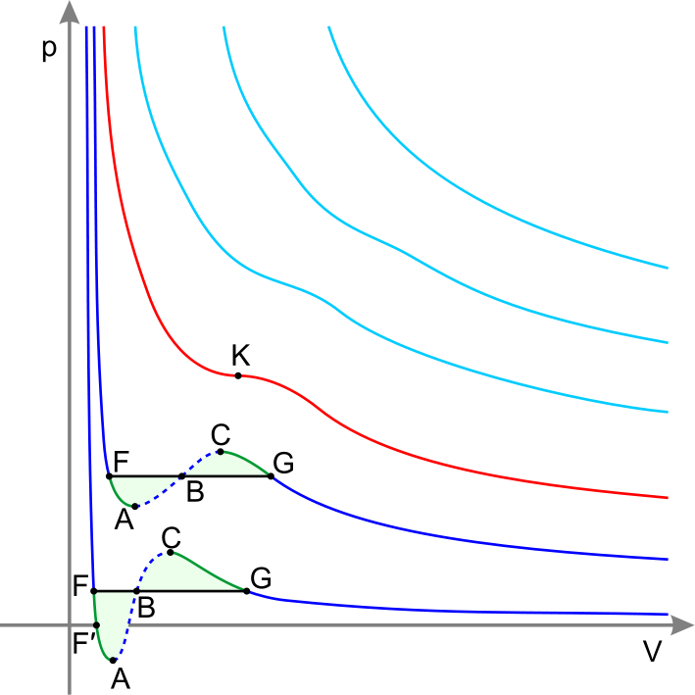


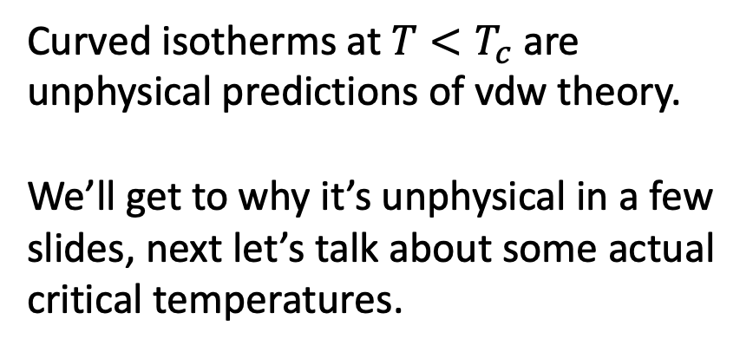
van der Waals formula actually does a good job when 𝑻>𝑻_{𝒄rit}
Isothermal compression in a PV diagram
$$T>T_{c}$$
$$T=T_{c}$$
T_{crit}
Curved isotherms at $T<T_{c}$ are unphysical predictions of vdw theory.
We’ll get to why it’s unphysical in a few slides, next let’s talk about some actual critical temperatures.

Slide 7
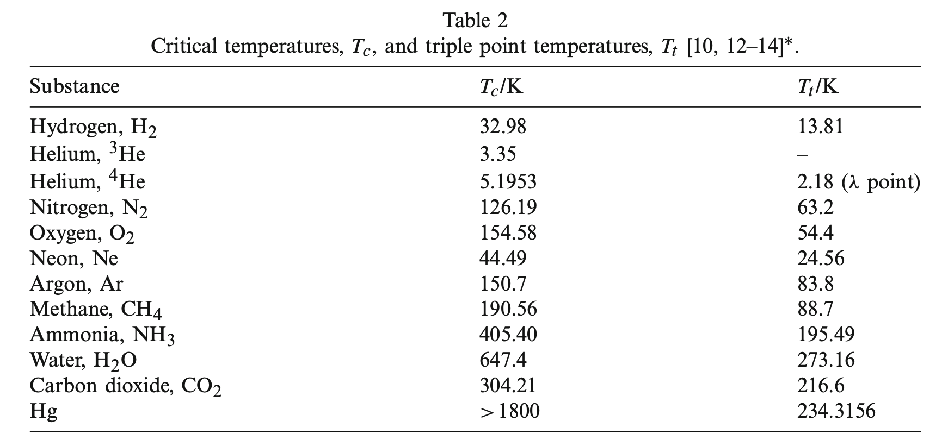

Every gas has its own critical temperature
$$T_{3}/K$$
From Berberberan-Santos et al, 2008

Slide 8

Every gas has its own critical temperature
$$T_{3}/K$$
From Berberberan-Santos et al, 2008
H₂ molecules are not very sticky, so it’s hard to liquify H₂ gas => H₂ has a really low critical temperature.

Slide 9
Every gas has its own critical temperature
$$T_{3}/K$$
From Berberberan-Santos et al, 2008
H₂O and NH₃ molecules are very sticky (they have hydrogen bonding!) so it’s easy to liquify them => H₂O and NH₃ have really high critical temperatures.

Slide 10
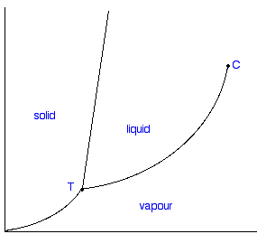



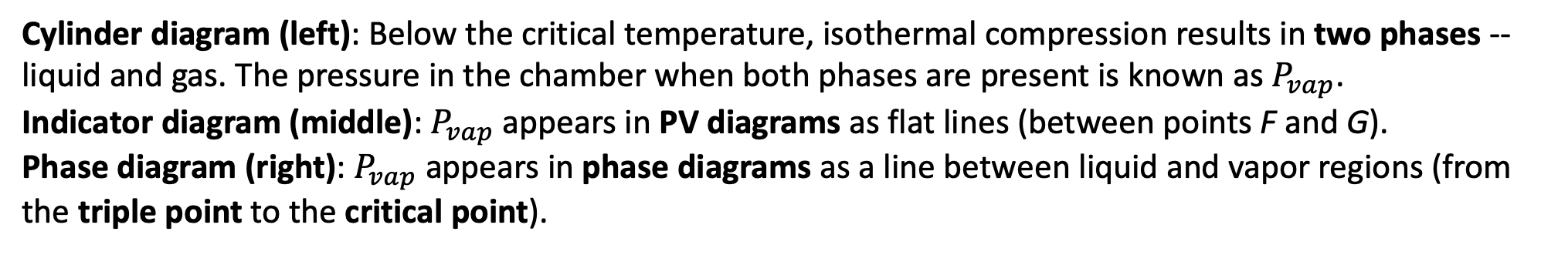


When the temperature is sub-critical ($T<T_{c}$), two phases (gas and liquid) are in equilibrium
Cylinder diagram (left): Below the critical temperature, isothermal compression results in two phases -- liquid and gas. The pressure in the chamber when both phases are present is known as $P_{vap}$.
Indicator diagram (middle): $P_{vap}$ appears in PV diagrams as flat lines (between points F and G).
Phase diagram (right): $P_{vap}$ appears in phase diagrams as a line between liquid and vapor regions (from the triple point to the critical point).
Cylinder diagram
Indicator diagram
Phase diagram
$$P$$
$$P$$
critical point
solid
liquid
gas
gas
triple point
liquid
gas
$$T<T_{crit}$$
$$V$$
$$T$$

Slide 11
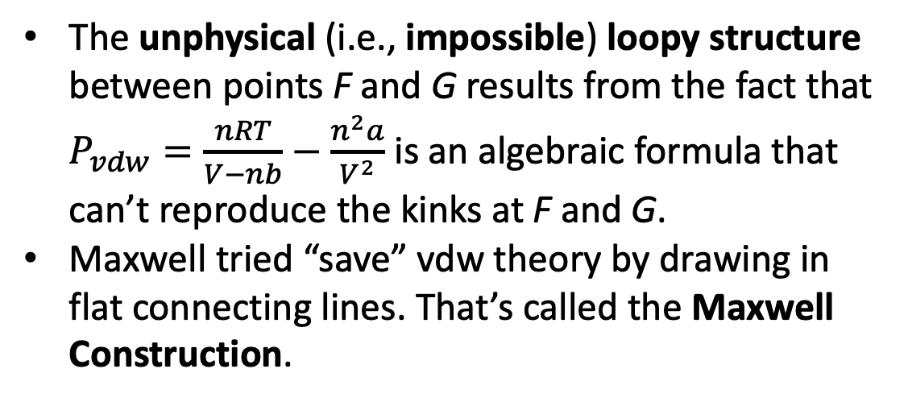
The unphysical (i.e., impossible) loopy structure of vdw isotherms below the critical temperature, and how Maxwell tried to fix vdw theory in that temperature regime
The unphysical (i.e., impossible) loopy structure between points F and G results from the fact that $P_{vdw}=\frac{nRT}{V−nb}−\frac{n^{2}a}{V^{2}}$ is an algebraic formula that can’t reproduce the kinks at F and G.
Maxwell tried “save” vdw theory by drawing in flat connecting lines. That’s called the Maxwell Construction.

Slide 12
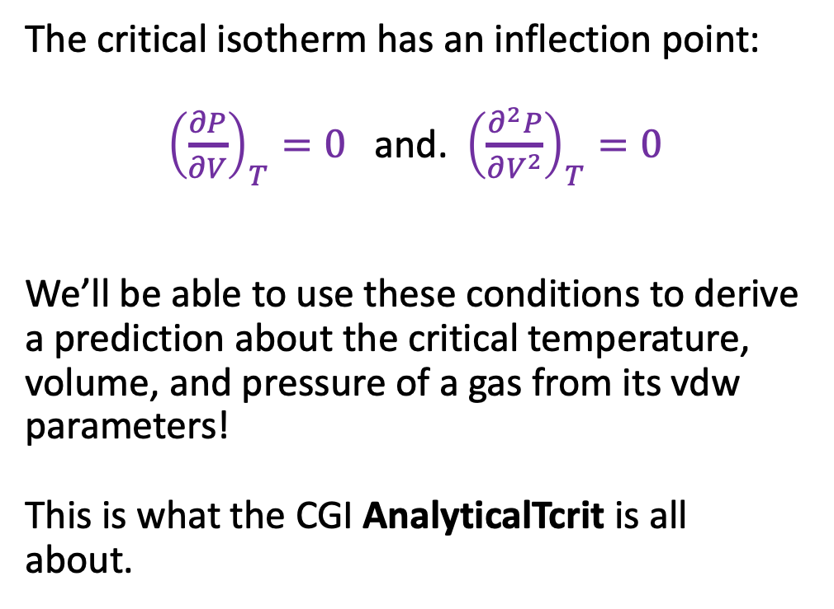
$V_{C}$, $T_{C}$, and $P_{C}$, and their relationship to vdw’s parameters
The critical isotherm has an inflection point:
${\left(\frac{∂P}{∂V}\right)}_{T}=0$ and. ${\left(\frac{∂^{2}P}{∂V^{2}}\right)}_{T}=0$
We’ll be able to use these conditions to derive a prediction about the critical temperature, volume, and pressure of a gas from its vdw parameters!
This is what the CGI AnalyticalTcrit is all about.

Slide 13
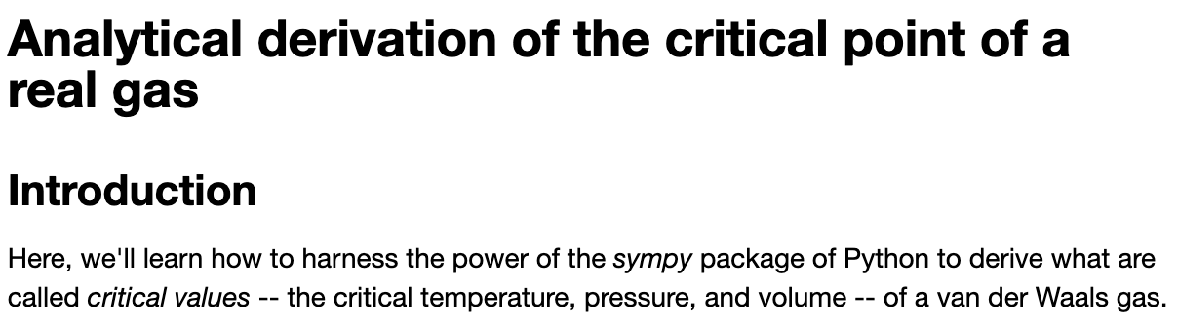
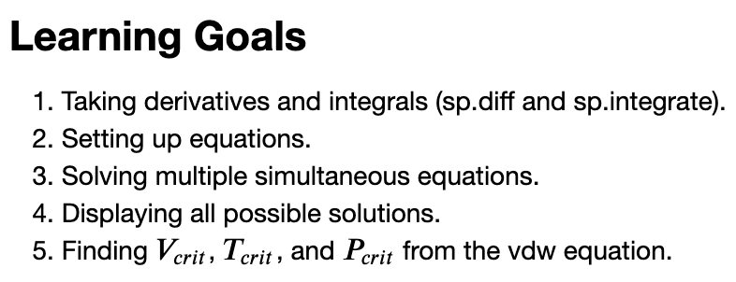
Let’s get started with AnalyticalTcrit …

